Slide 1

CM20315 - Machine Learning
Prof. Simon Prince
13. Unsupervised learning

Slide 2
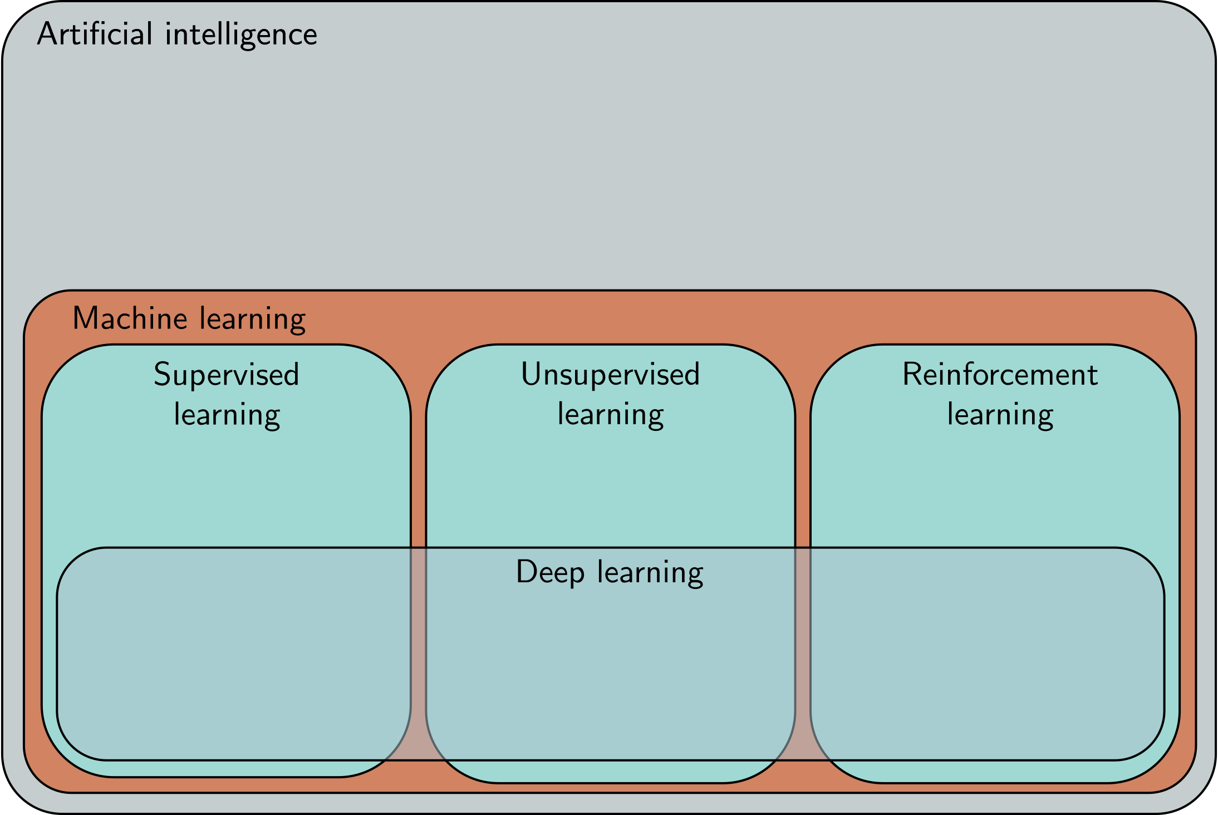

Slide 3
Semester 1

Slide 4
Supervised vs. unsupervised learning
Supervised learning maps data x to labels y based on example training pairs
Unsupervised learning only has the data x
Goals:
Generate new example
Denoise examples
Find outliers
Understand structure of data
Compress data
Manipulate data
Interpolate between data points

Slide 5
Generative = can generate new examples
Probabilistic = can assign probability to data examples

Slide 6
Probabilistic models
Maximize log likelihood of training data

Slide 7
Latent variable models
Latent variable models map a random “latent” variable to create a new data sample

Slide 8
Types of unsupervised generative model
Generative adversarial networks (GANs) (LV)
Variational auto-encoders (VAEs) (P, LV)
Diffusion models (P, LV)
Normalizing flows (P, LV)
Energy models (P)
Autoregressive models (P)

Slide 9
Decoder model: GPT3
One job: predict the next word in a sequence
More formally builds an autoregressive probability model
Doesn’t use latent variables, but is probabilistic and generative
Can generate new examples
Can assign a probability to new data

Slide 10
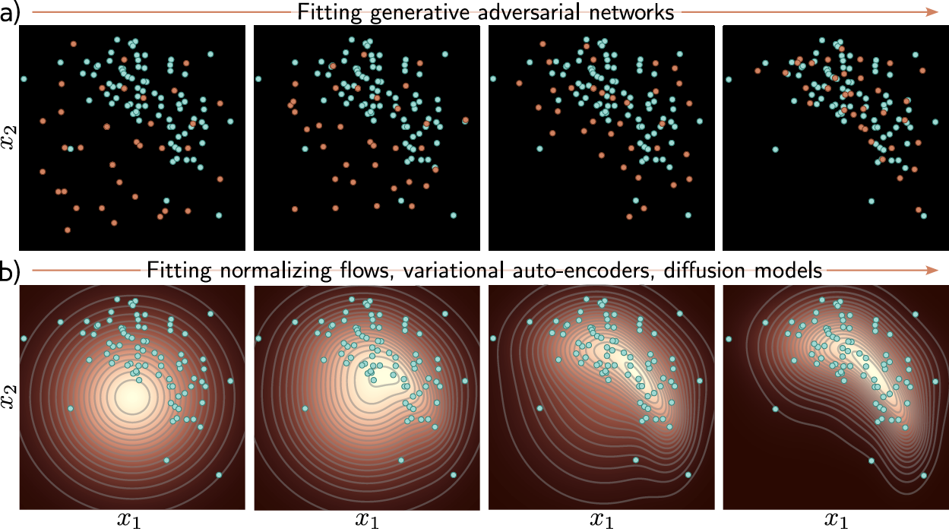

Slide 12
What makes a good model?
Eﬀicient sampling: Generating samples from the model should be computation- ally inexpensive and take advantage of the parallelism of modern hardware.
High-quality sampling: The samples should be indistinguishable from the real data that the model was trained with.
Coverage: Samples should represent the entire training distribution. It is insuf- ficient to only generate samples that all look like a subset of the training data.
Well-behaved latent space: Every latent variable z should correspond to a plausible data example x and smooth changes in z should correspond to smooth changes in x.
Interpretable latent space: Manipulating each dimension of z should corre- spond to changing an interpretable property of the data. For example, in a model of language, it might change the topic, tense or degree of verbosity.
Eﬀicient likelihood computation: If the model is probabilistic, we would like to be able to calculate the probability of new examples eﬀiciently and accurately

Slide 13
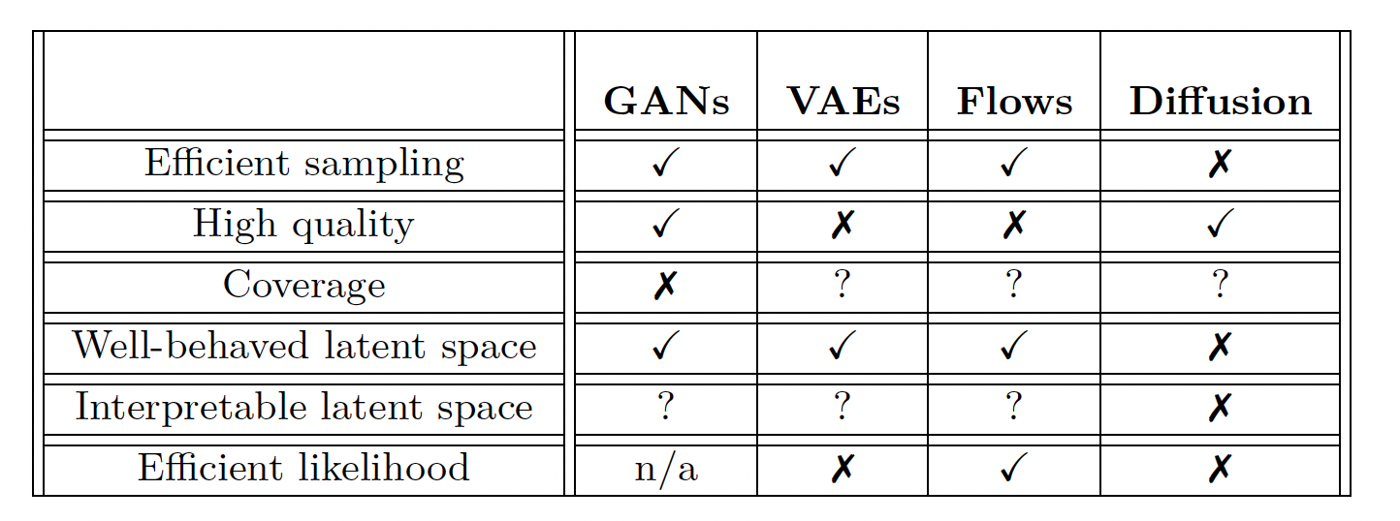
Do we have good models?
How to measure performance within or between categories?
Open research area.
When probabilistic, log probability of test data is one way

